Slide 1
CARDIO-PULMONARY RESUSCITATION
ROLE AND MANAGEMENT
Presented by s/n Jayanthy and s/n Tindu
PHDU

Slide 2
DEFINITION
CARDIOPULMONARY RESUSCITATION (CPR) IS A PROCEDURE TO SUPPORT AND MAINTAIN BREATHING AND CIRCULAITON FOR AN INFANT , CHILD OR ADOLESCENT WHO HAS RESPIRATORY ARREST OR CARDIAC ARREST
PURPOSE
CPR IS PERFORMED TO RESTORE AND MAINTAIN BREATHING AND CIRCULATION TO PROVIDE OXYGEN AND BLOOD FLOW TO THE HEART ,BRAIN AND OTHER VITAL ORGAN S

Slide 3
Introduction
Nurses play a vital role in managing paediatric emergencies hence ,it is important that nurses are well equipped with all the essential knowledge and skills of managing paediatric emergencies .
The aim to empower paediatric nurses with knowledge and skills of managing CPR
It includes how to assess sick child ,Role of nurses in CPR, CPR algorithm

Slide 4
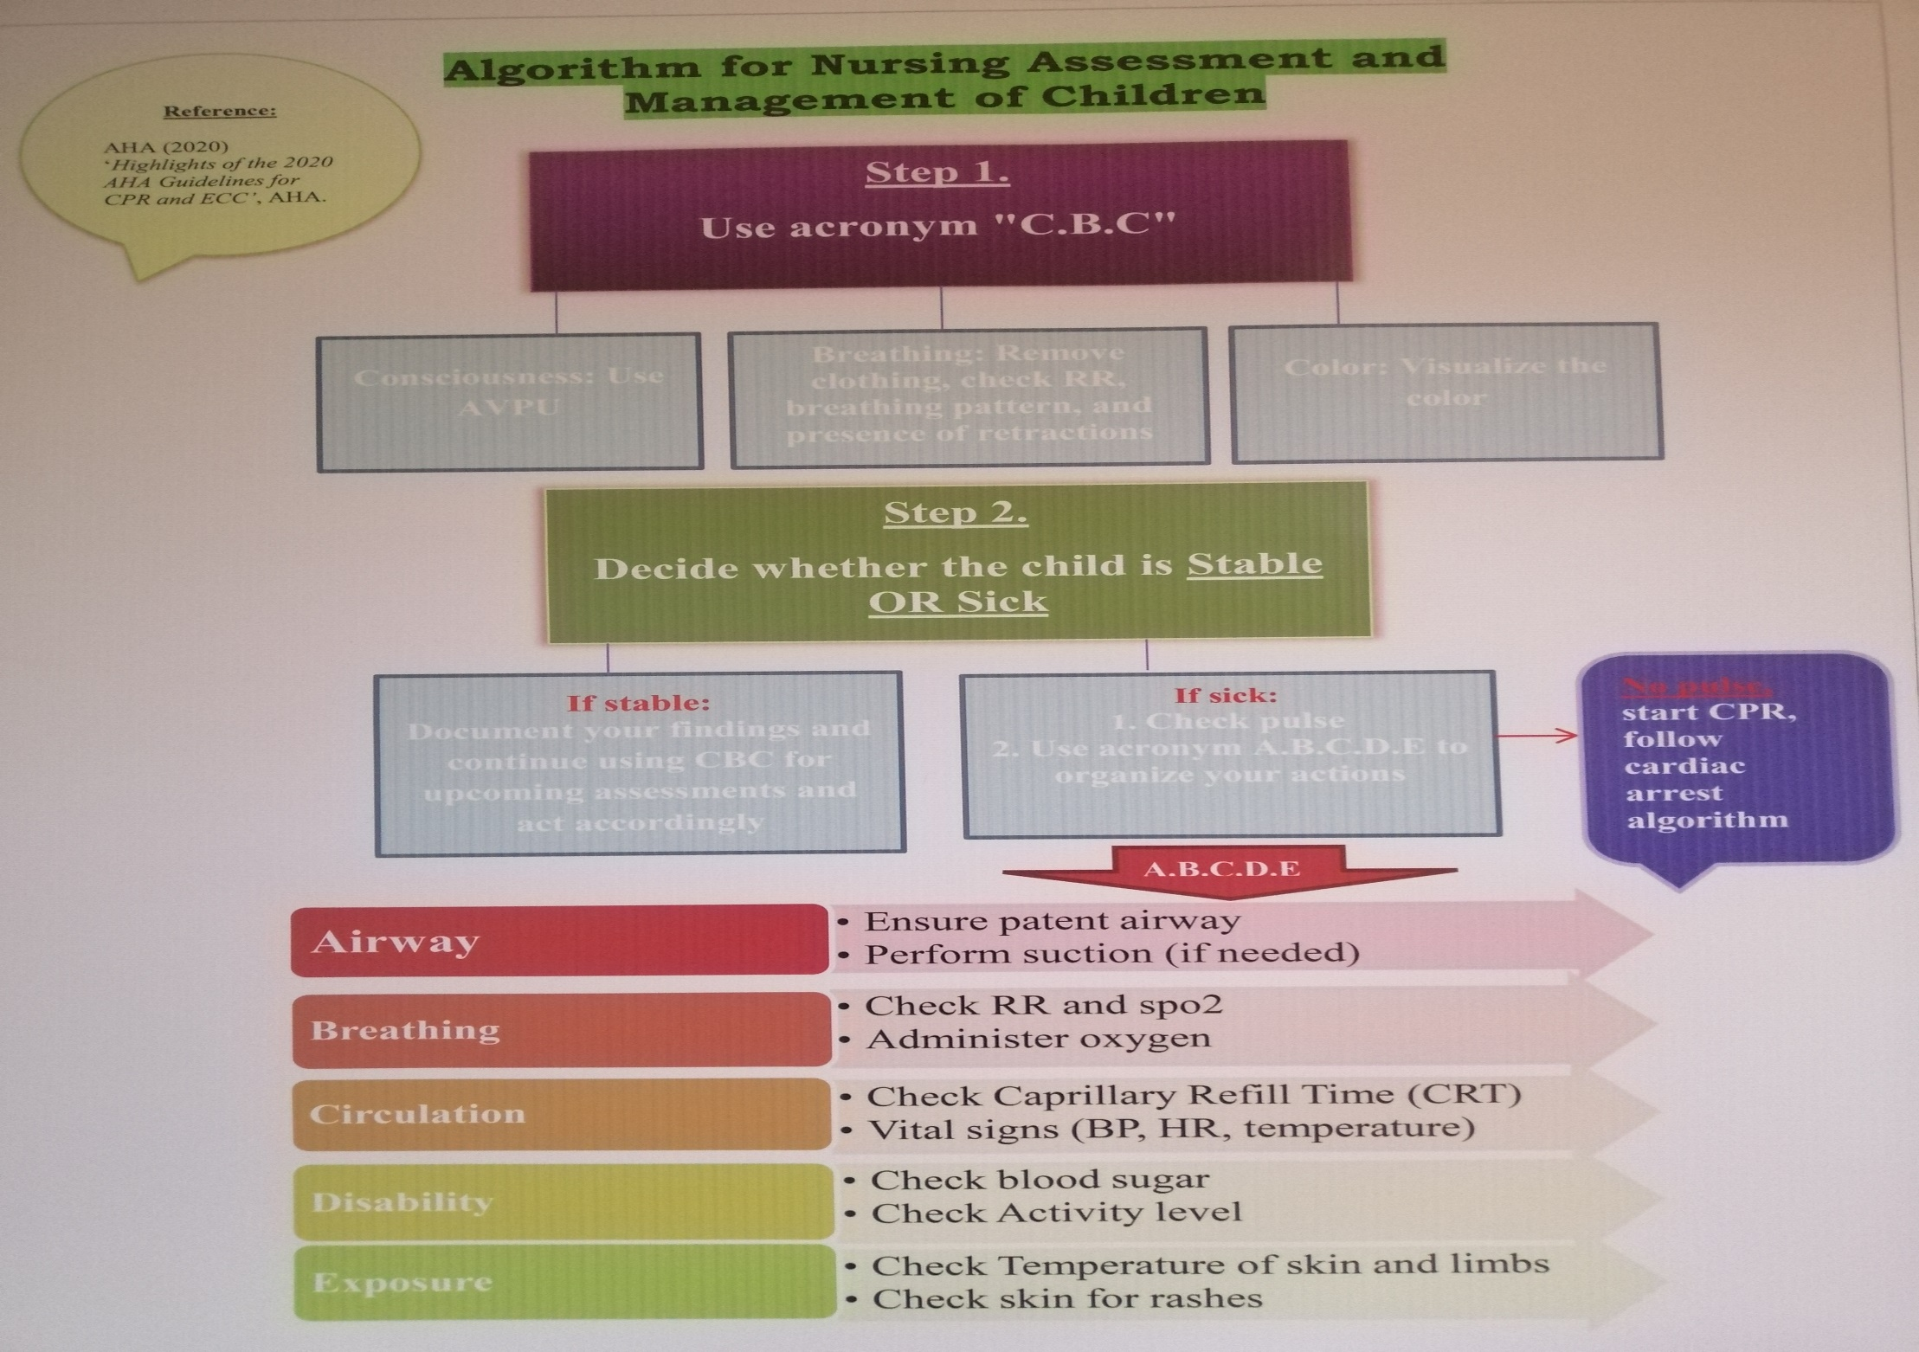

Slide 5
THE ROLE OF NURSES IN CARDIOPULMONARY RESUSCITATION (CPR)

Slide 6
Situation | Expected Action | Done | Not Done | Comment
 | 1st nurse
Recognise patient in cardiac arrest | Asses patient responsiveness by tapping his /her shoulders asking “are you ok?”
Call for help | Pull the emergency bell
time | Note the time
Positioning the patient | Make the bed flat , Remove the pillow
Assessment of pulse | Checking pulse for not more than 10 seconds
If alone one rescure CPR | Start high quality chest compression -correct hand position -rate at least 100/mt Adequate depth 5cm Allow chest recoil
Second Nurse arrived two rescuer CPR | Handle airway , connect self inflating bag to 100% oxygen,15L/mt. Open air way head, head tilt, chin lift -position self inflating bag correctly -correct hand ,arms and shoulders positioning -start ventilation , make sure of chest rise.

Slide 7
 | Second Nurse
Confirming the cardiac arrest | Confirm the cardiac arrest by asking 1 st nurse
Calling the team | Dialing 9555 -answering Upon operators respose –announcing “CARDIAC ARREST” and location of arrest 3 times slowly and clearly.
Crash cart | Take crash cart to side of the patient
Head board | Remove head board of the patient bed
Cardiac board | The cardiac board in position Length wise
Timer | Start timer
2nd Rescuer CPR | Take over chest compression and provide High quality 2 rescure cpr until team arrive.

Slide 8
AFTER ARRIVAL OF CARDIAC TEAM
FIRST NURSE
 | Connect self inflating bag to oxygen Assists in airway management: -fix laryngoscope blade correctly -handle ET tube with jel and stillet to anesthetist -inflate the ETT cuff with 5 ml syringe -tie the ET tube with elastoplaster with correct technique , mention the level also(fix in cm)
 | Suction
 | Administrator medication(note time , dose and route of medications/jouls)

Slide 9
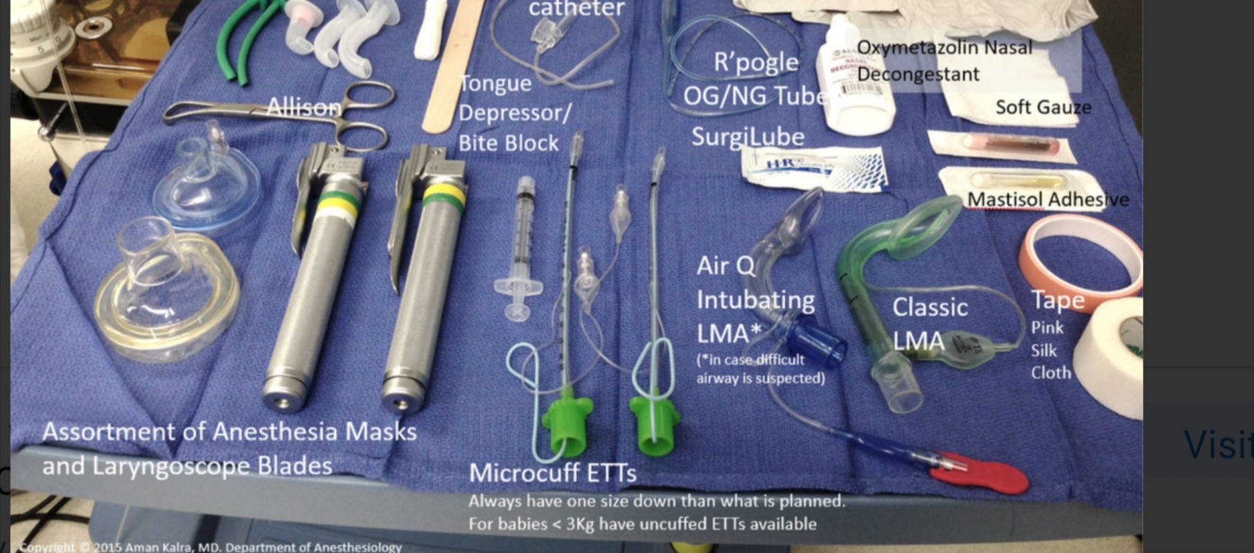
ENTOTRACHEAL INTUBATION EQUIPMENTS

Slide 10
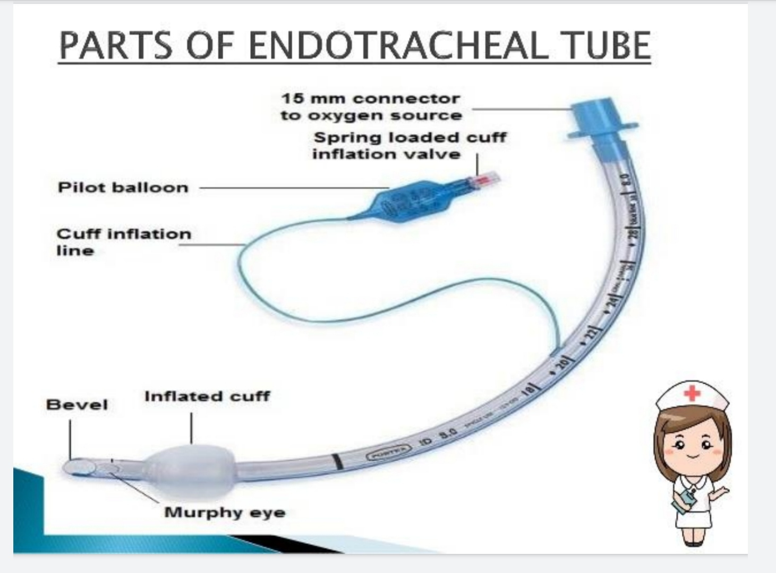

Slide 11
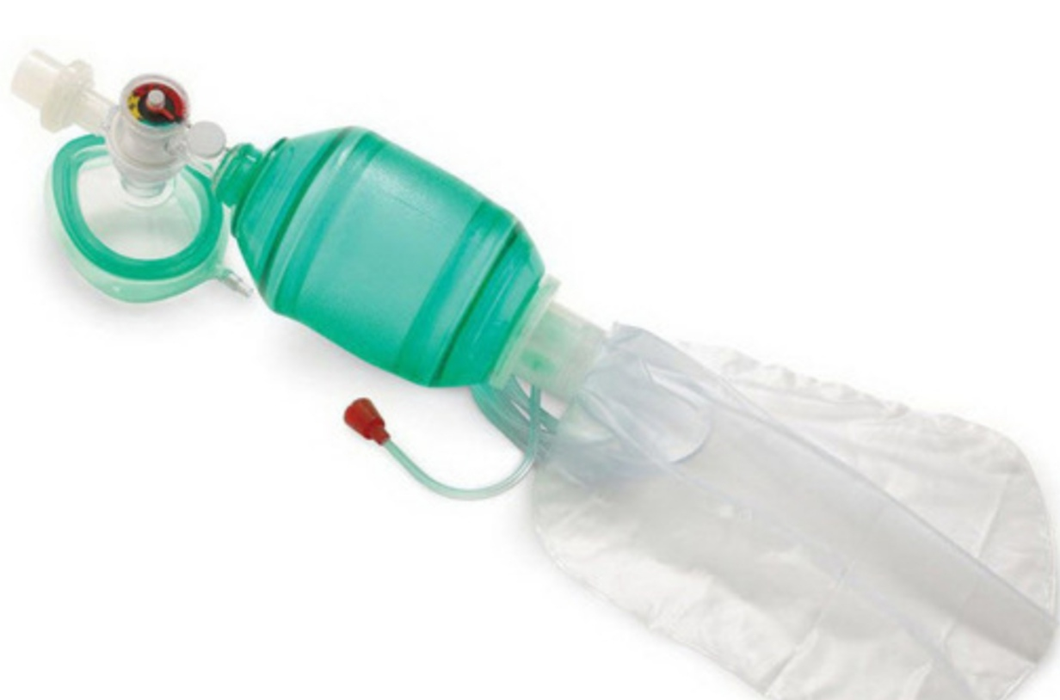

Slide 12
 | SECOND NURSE
 | Electrodes are fixed maximum possible higher leaving space for shock paddles
 | Fix the Cables correctly ,Right side, yellow left side ,green left lateral side of chest
 | Switching on monitor Keep the monitor on leads mode
 | Start iv line
 | Assist in investigation
 | Prepare medication as per doctor order

Slide 13
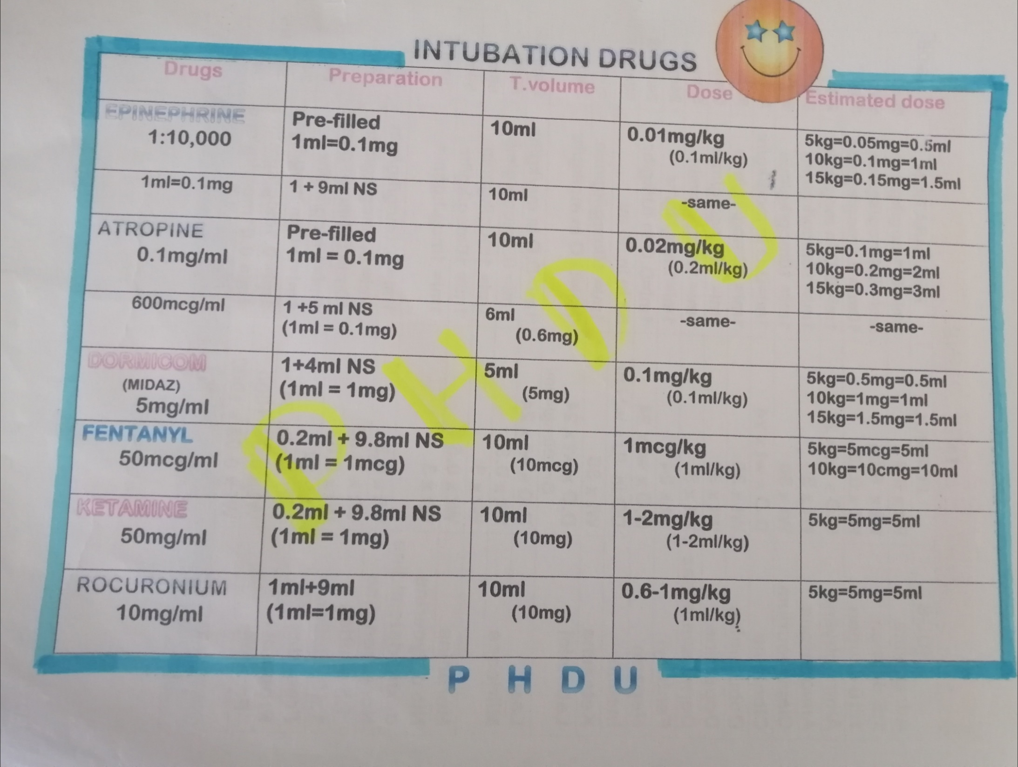
INTUBATION MEDICATIONS

Slide 14
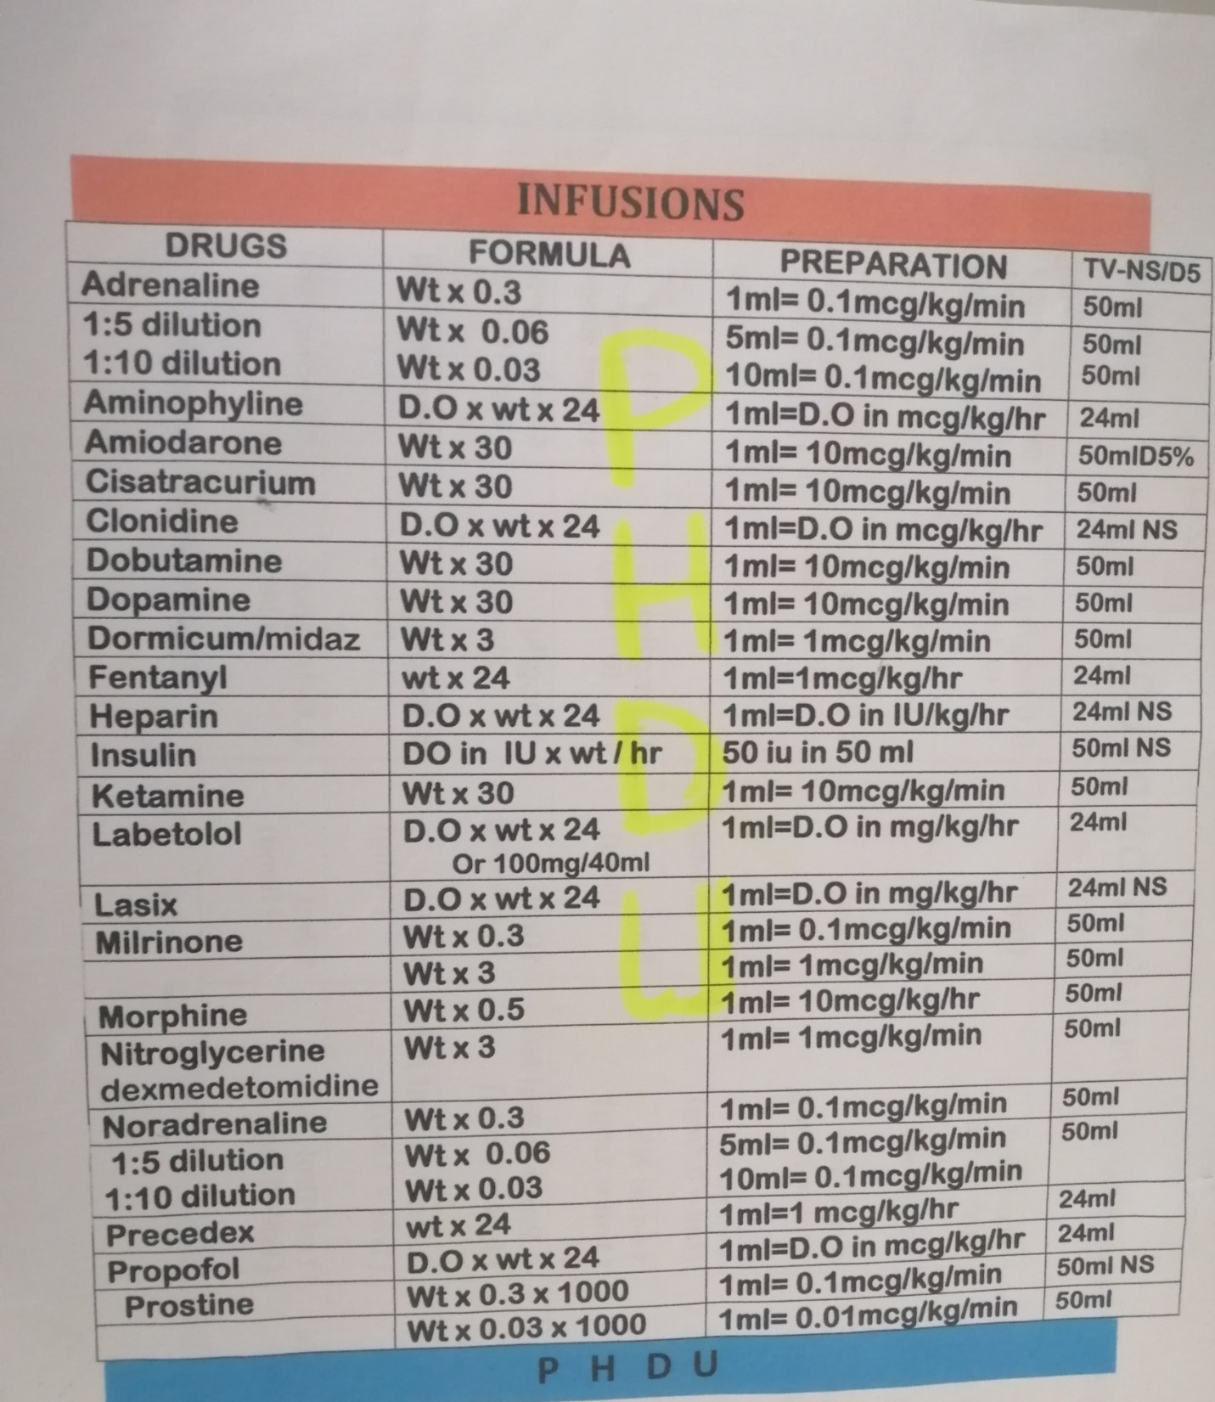
INFUSION MEDICAITONS

Slide 15
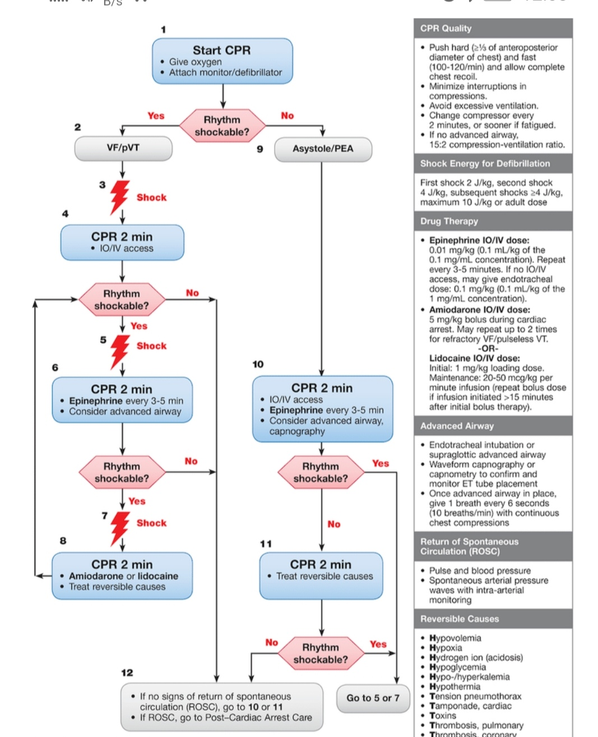

Slide 16
ALGORITHAM FOR PEAEDATRIC CPR
UNRESPONSIVE CHILD :
Assess the breathing and pulse
Breathing absent , Pulse absent | Breathing absent , Pulse present
start CPR ,reassess after 2 mins | rescue breath(20 -30 breath/minute)
to be done with the help of AED (automated external Defibrillator) two pads to connect to The chest and look for the rhythm NON SHOCKABLE RHYTHUM AND SHOCKABLE RYTHUM | recheck pulse every 2 mts
 | If no pulse /pulse less than 0 to 60/min with poor perfusion ; start CPR if only one Resecure 30:2 , if two Rescure 15:2.

Slide 17
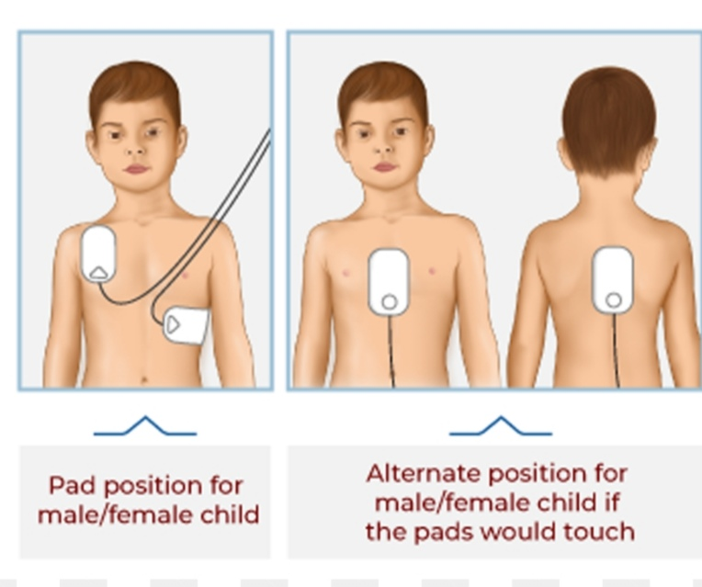

Slide 18
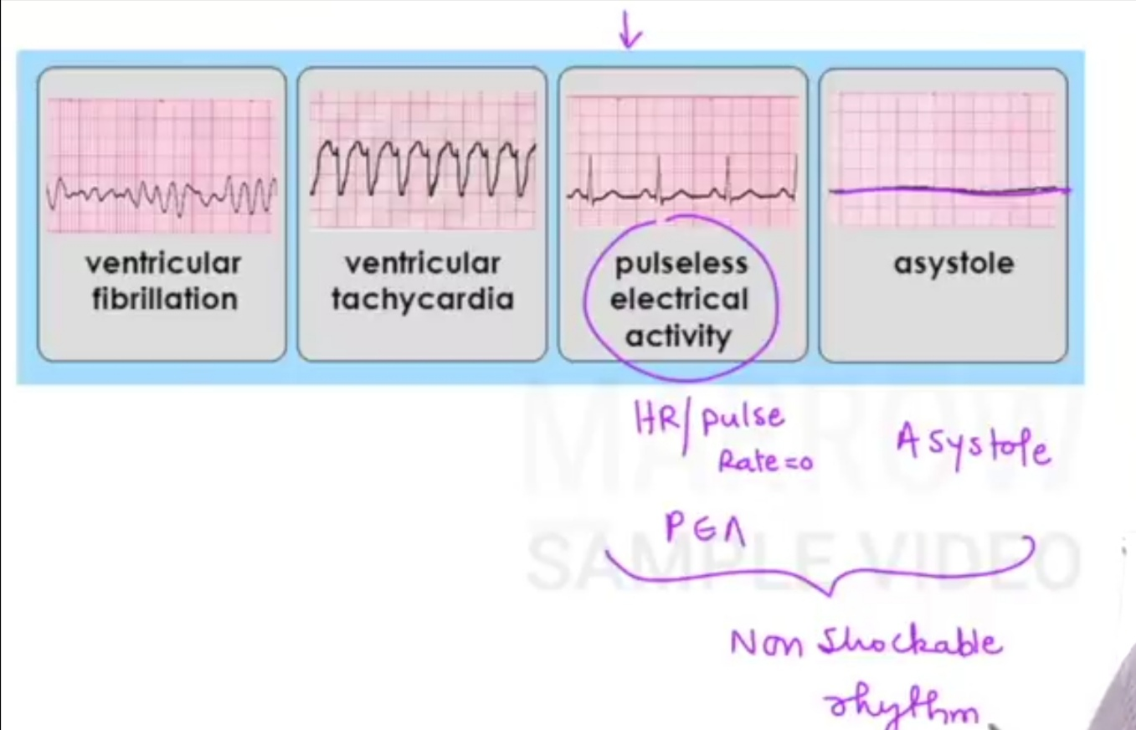
Shockable and Non Shockable Rhythm

Slide 19
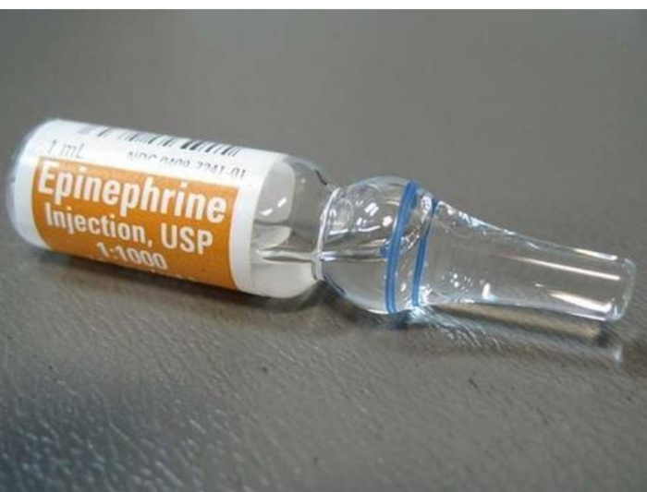
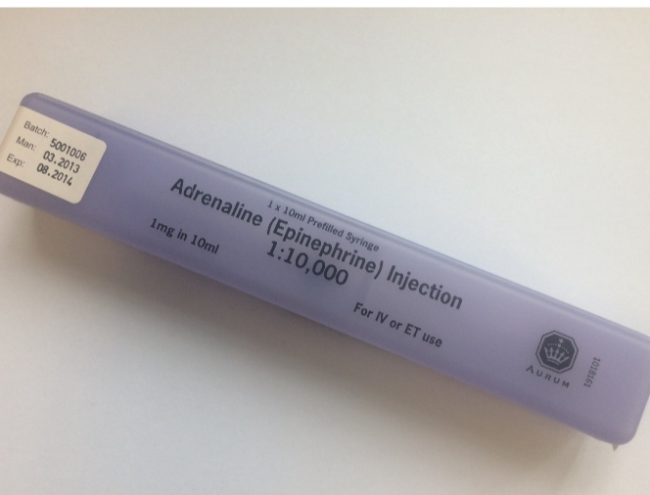
Early use of adrenaline for non shockable rhythm, if use adrenaline with in 5 minutes after starts CPR get good outcome
Strength of adrenaline 1:10000 Strength of adrenaline 1:1000
0.01 mg/kg or 0.1ml/kg
If there is no iv/io access ,may give endotracheal dose :0.1 mg/kg (0.1 ml/kg of the 1 mg/ml concentration

Slide 20
SHOCKABLE RHYTHM
ventricular fibrillation ventricular tachycardia
2 J/kg , total dose not exceed 10J/kg

Slide 21
Reversible causes And Management
If detected and corrected very good outcome
So it is very important in CPR management
4 H | 4 T
Hypovolemia | Tension Pneumothorax
Hypoxia | Toxins /drugs
Hypothermia | Thromboembolism(pul)
Hyperkalemia | Tamponade( cardiac)

Slide 22
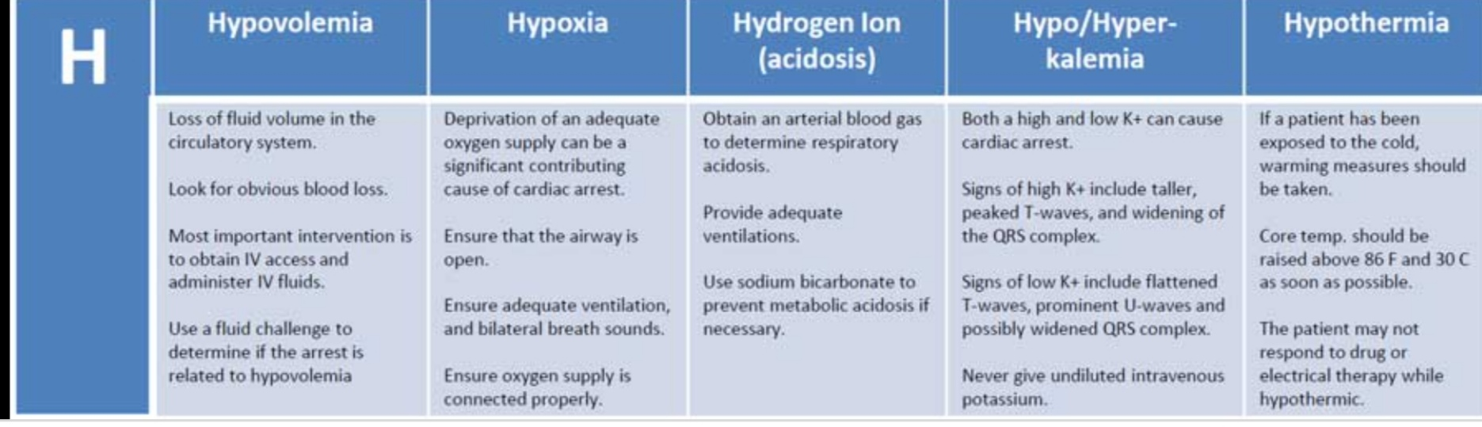

Slide 23
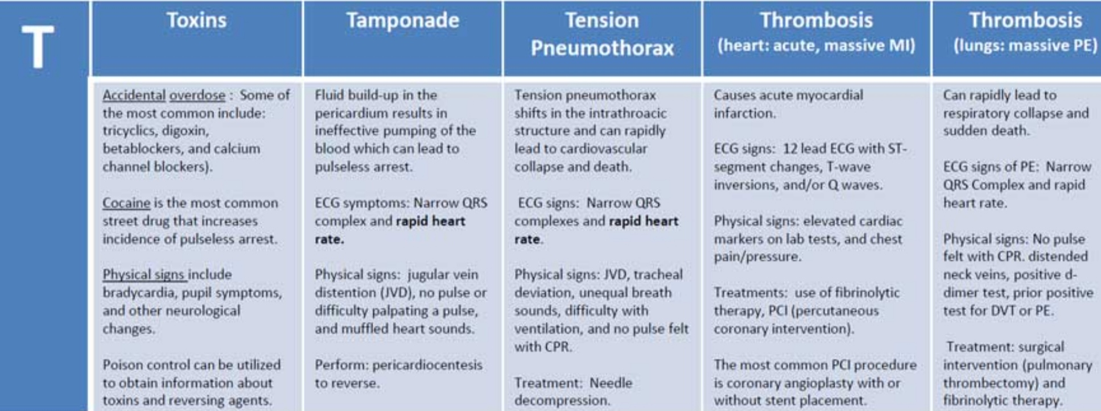

Slide 24
Now Lets watch a short video on Infant CPR

Slide 25
Thank you

